Slide 1

Chapter 17
User Interface Design

Slide 2
Objectives
Distinguish between different types of computer users and design considerations for each.
Identify several important human engineering factors and guidelines and incorporate them into a design of a user interface.
Integrate output and input design into an overall user interface that establishes the dialogue between users and computer.
Understand role of operating systems, web browsers, and other technologies for user interface design.
Apply appropriate user interface strategies to an information system. Use a state transition diagram to plan and coordinate a user interface.
Describe how prototyping can be used to design a user interface.

Slide 3
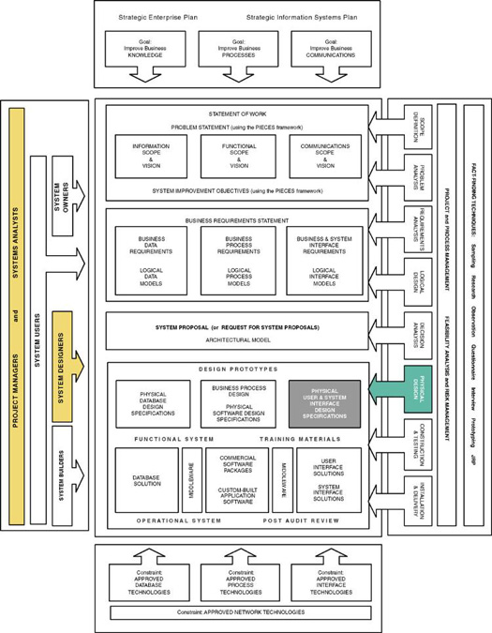
Notes:
Chapter 17 – User Interface Design

Slide 4
System User Classifications
Expert User – an experienced computer user
  Spends considerable time using specific application programs.
  Use of a computer is usually considered non-discretionary.
  In the mainframe computing era, this was called a dedicated user.
Novice User – a less experienced computer user
  Uses computer on a less frequent, or even occasional, basis.
  Use of a computer may be viewed as discretionary (although this is becoming less and less true).
  Sometimes called a casual user.

Slide 5
Interface Problems
According to Galitz, the following problems result in confusion, panic, frustration, boredom, misuse, abandonment, and other undesirable consequences.
  Excessive use of computer jargon and acronyms
  Nonobvious or less-than-intuitive design
  Inability to distinguish between alternative actions (“what do I do next?”)
  Inconsistent problem-solving approaches
  Design inconsistency

Slide 6
Commandments of User Interface Design
Understand your users and their tasks.
Involve the user in interface design.
Test the system on actual users.
Practice iterative design.

Slide 7
Human Engineering Guidelines
The user should always be aware of what to do next
  Tell user what the system expects right now.
  Tell user that data has been entered correctly.
  Tell user that data has not been entered correctly.
  Explain reason for a delay in processing.
  Tell user a task was completed or not completed.
Format screen so instructions and messages always appear in same general display area.
Display messages and instructions long enough so user can read them.

Slide 8
Human Engineering Guidelines (continued)
Use display attributes sparingly.
Default values should be specified.
Anticipate errors users might make.
Users should not be allowed to proceed without correcting an error.
If user does something that could be catastrophic, the keyboard should be locked to prevent any further input, and an instruction to call the analyst or technical support should be displayed.

Slide 9
Guidelines for dialogue Tone and Terminology
Dialogue – the overall flow of screens and messages for an application
Tone:
  Use simple, grammatically correct sentences.
  Don’t be funny or cute!
  Don’t be condescending.
Terminology
  Don’t use computer jargon.
  Avoid most abbreviations.
  Use simple terms.
  Be consistent in your use of terminology.
  Carefully phrase instructions—use appropriate action verbs.

Slide 10
User Interface Technology
Operating Systems and Web Browsers
  GUI
  Windows, Macintosh, UNIX, Linux, Palm OS, Windows CE
  Growing importance of platform independence
Display Monitor
  Regular PC monitors
  Non-GUI terminals
  Growing importance of devices such as handhelds
  Paging – Display complete screen of characters at a time.
  Scrolling – Display information up or down a screen one line at a time.
Keyboards and Pointers
  Mouse
  Pens

Slide 11
Graphical User Interfaces Styles and Considerations
Windows and frames
Menu-driven interfaces
  Pull-down and cascading menus
  Tear-off and pop-up menus
  Toolbar and iconic menus
  Hypertext and hyperlink menus
Instruction-driven interfaces
  Language-based syntax
  Mnemonic syntax
  Natural language syntax
Question-answer dialogue

Slide 12
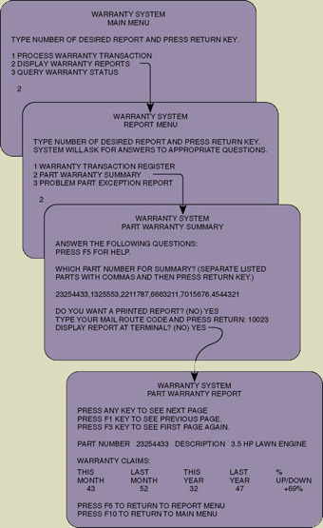
A Classical Hierarchical Menu Dialogue

Slide 13
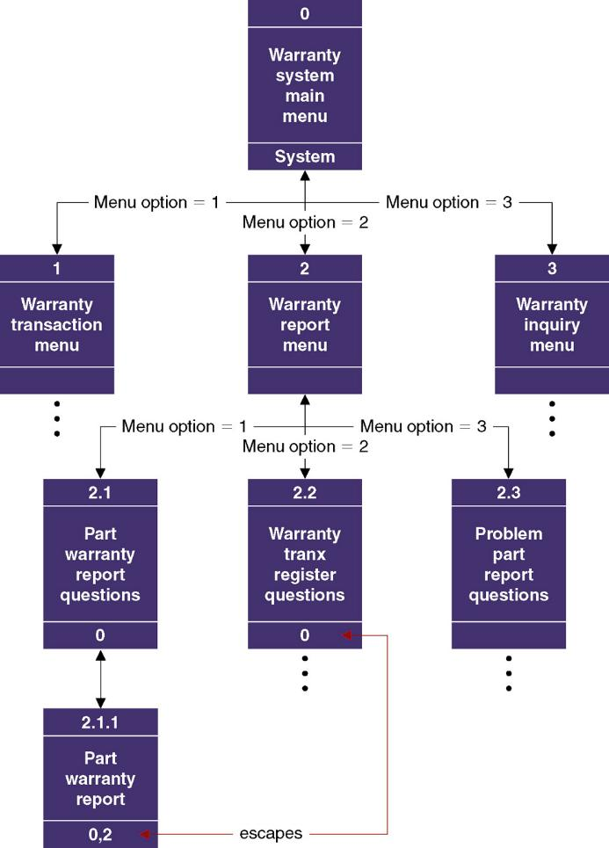
Sample Dialogue Chart

Slide 14
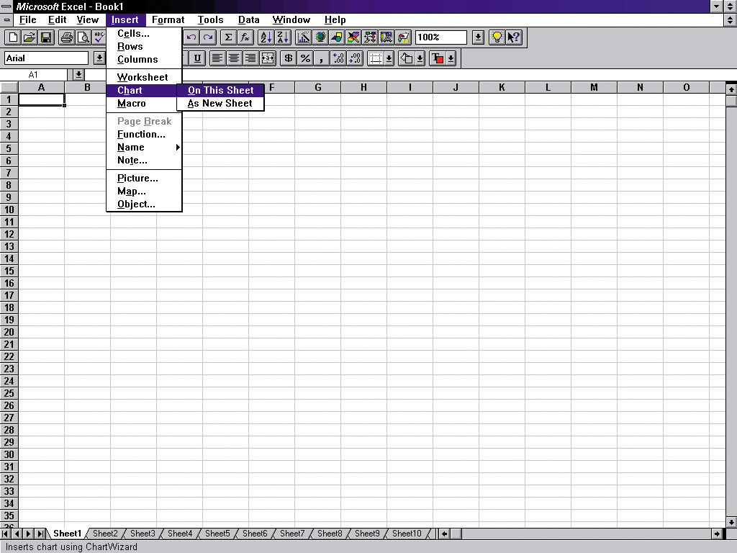
Pull-Down and Cascading Menus
menu bar
Cascading menu
Ellipses indicates dialogue box
Pull-down menu

Slide 15
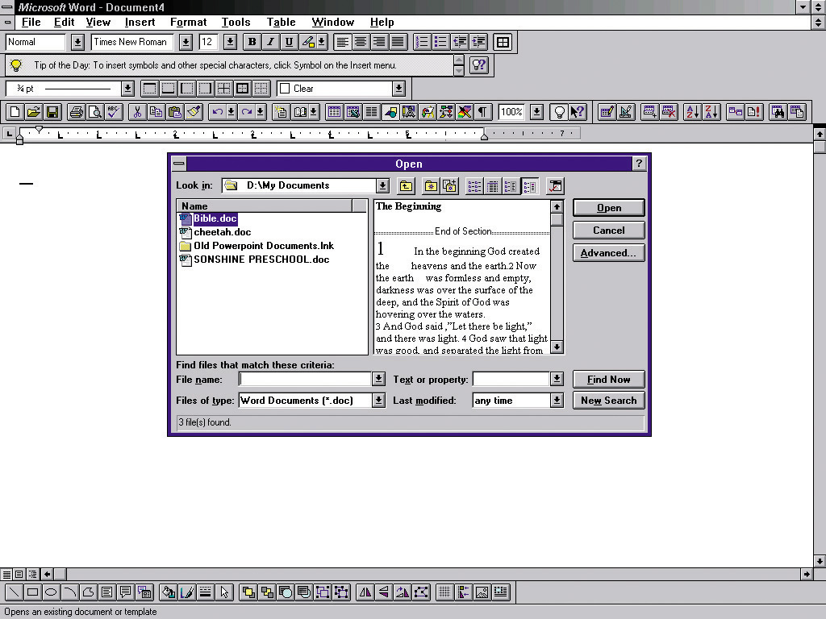
Dialogue Box

Slide 16
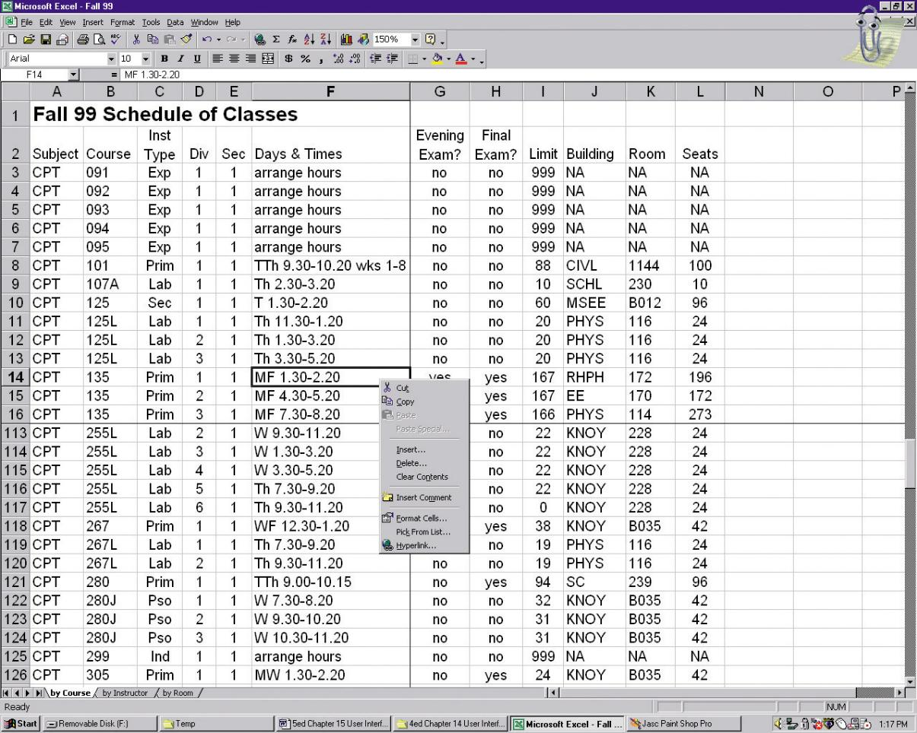
Pop-Up Menus

Slide 17
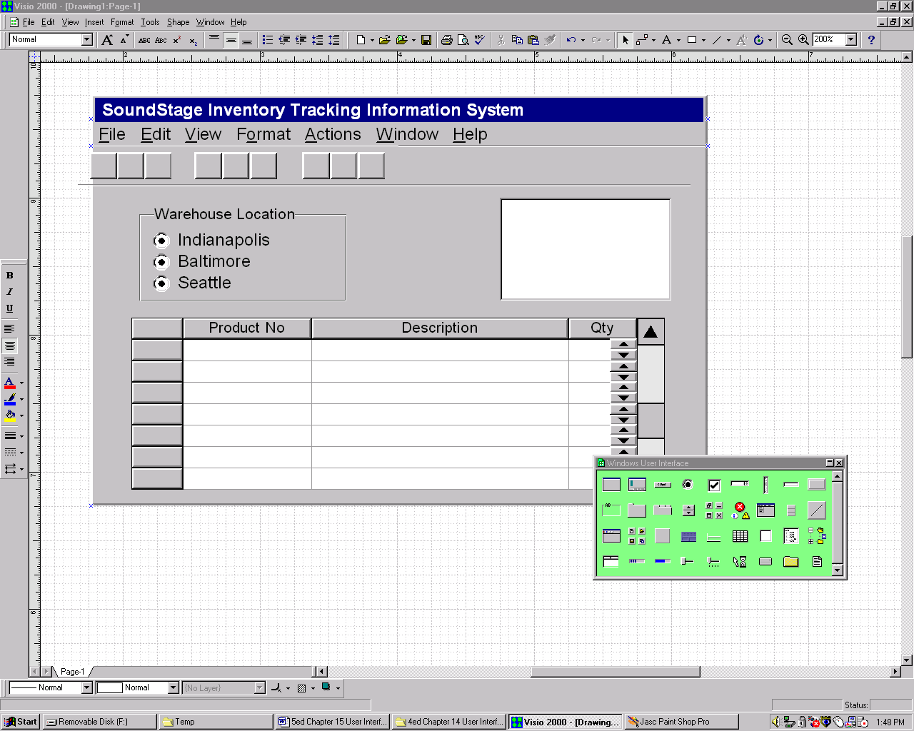
Tool Bars

Slide 18
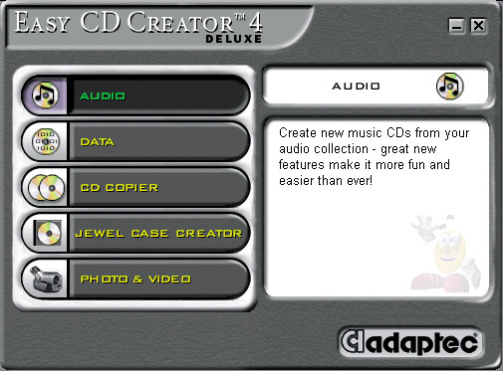
Iconic Menus

Slide 19
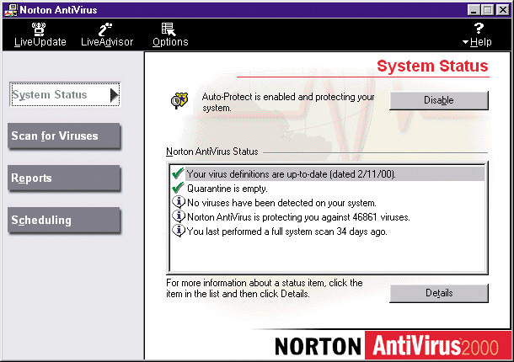
Consumer-Style Interface

Slide 20
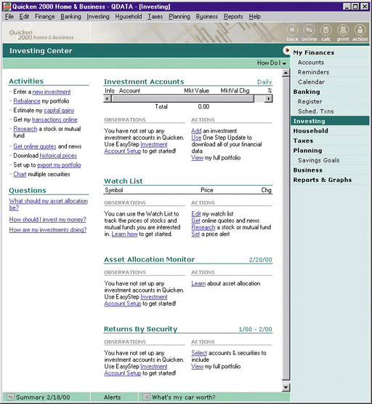
Hybrid Windows/Web Interface

Slide 21
Instruction-Driven Interfaces
Language-based syntax is built around a widely accepted command language that can be used to invoke actions
  SQL
Mnemonic syntax is built around commands defined for custom information systems.
  Commands unique to that system and meaningful to user
Natural language syntax allows users to enter questions and command in their native language

Slide 22
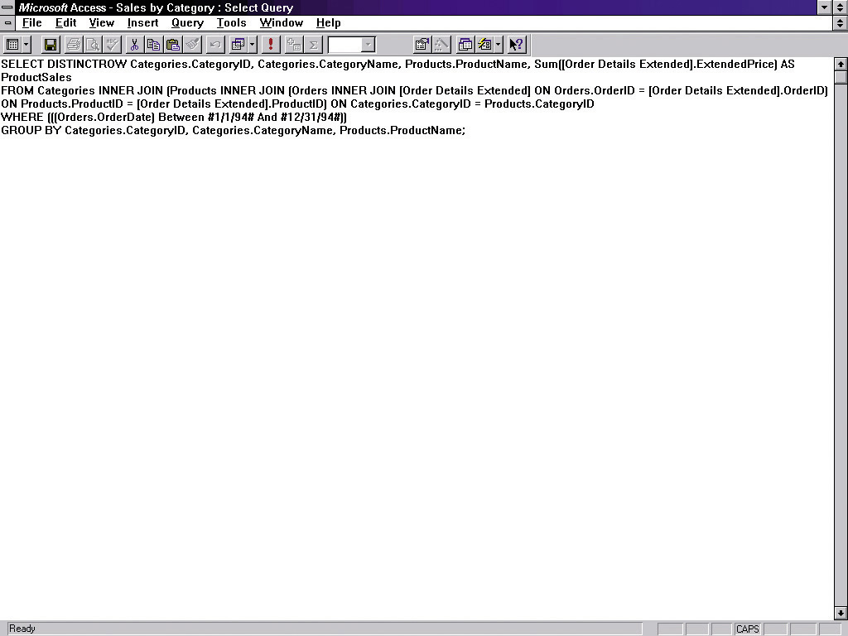
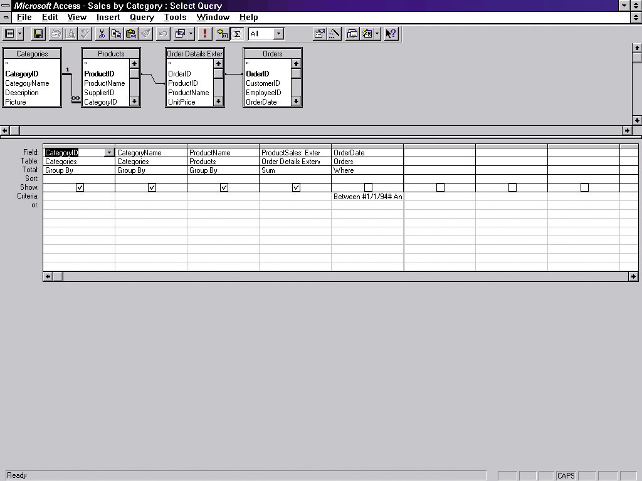
Instruction-Driven Interface

Slide 23
Special Considerations for User Interface Design
Internal Controls – Authentication and Authorization
  User ID and Password
  Privileges assigned to roles
  Web certificates
Online Help
  Growing use of HTML for help systems
  Help authoring packages
  Tool tips
  Help wizards
  Agents – reusable software object that can operate across different applications and networks.

Slide 24
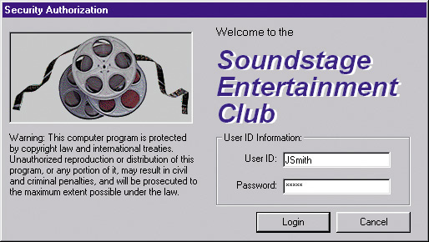
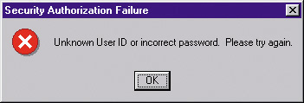
Authentication Log-in Screen and Error Screen

Slide 25
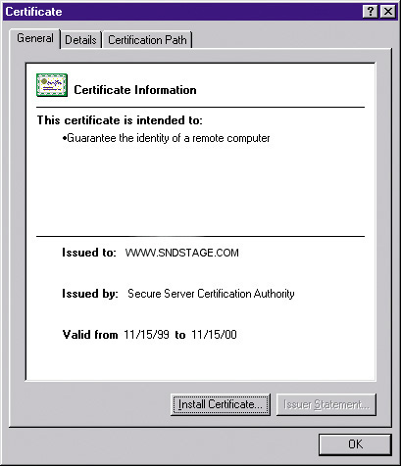
Server Security Certificate

Slide 26
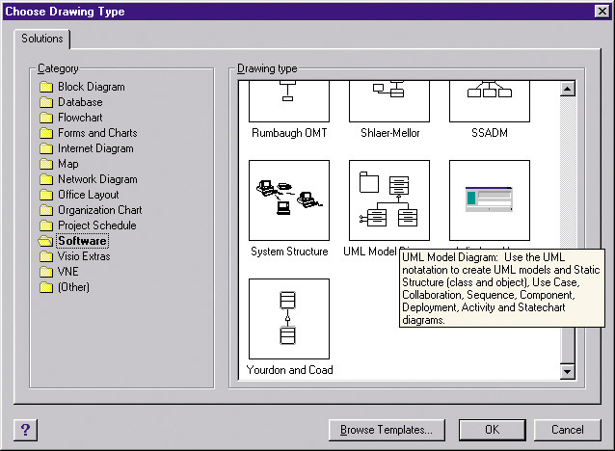

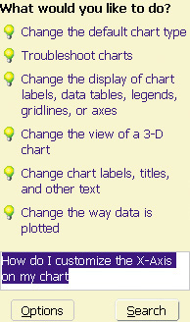
Help Tool Tip, Help Agent, and Natural Language Processing

Slide 27
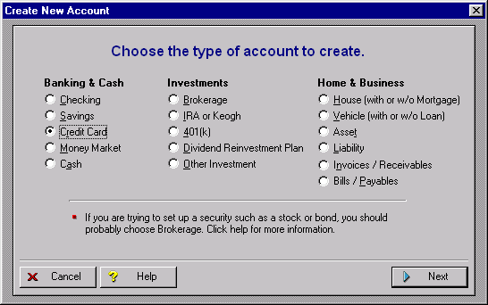
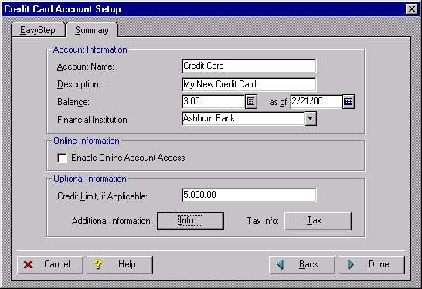
Help Wizard

Slide 28
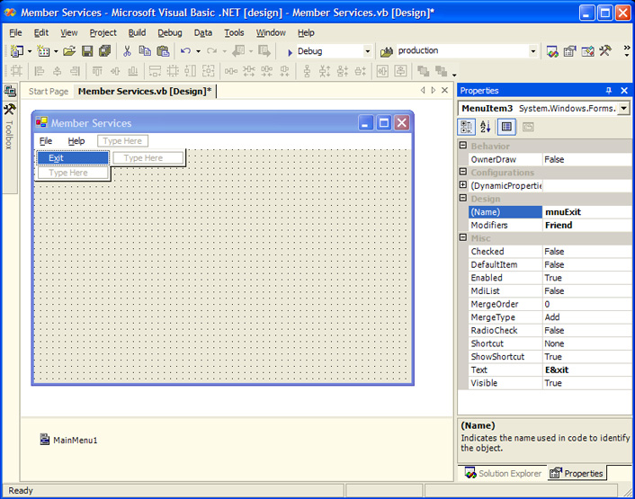
Automated Tools for User Interface Design & Prototyping
Microsoft Access
CASE Tools
Visual Studio
Excel
Visio
Visual Studio .NET Menu Construction

Slide 29
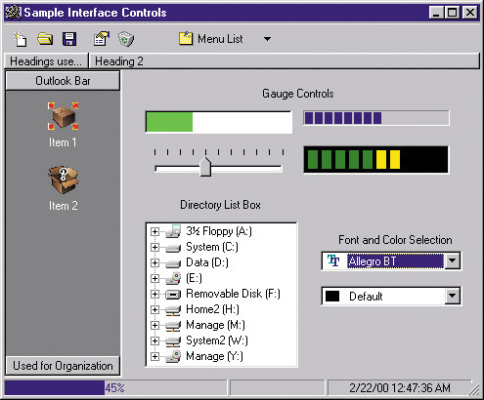
Additional User Interface Controls in Visual Basic

Slide 30
The User Interface Design Process
Chart the user interface dialogue.
State Transition Diagram– a tool used to depict the sequence and variation of screens that can occur during a user session.
Prototype the dialogue and user interface.
Obtain user feedback.
  Exercising (or testing) the user interface
If necessary return to step 1 or 2

Slide 31
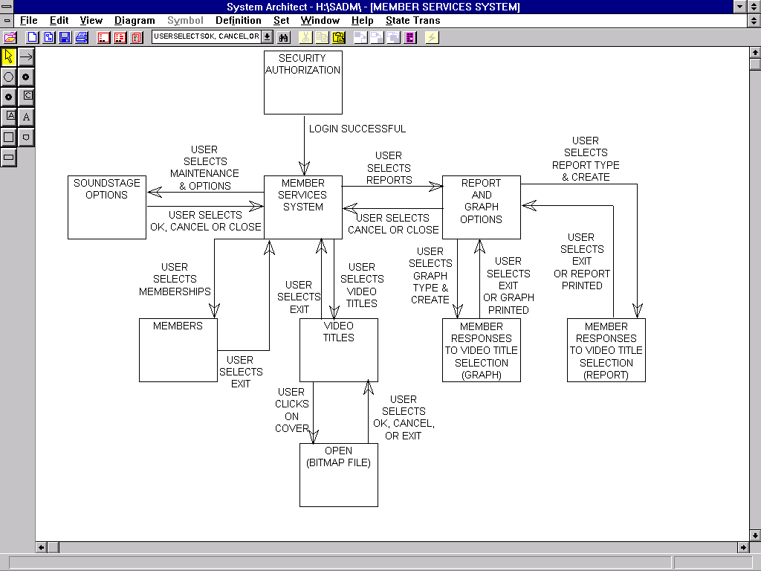
SoundStage Partial State Transition Diagram

Slide 32
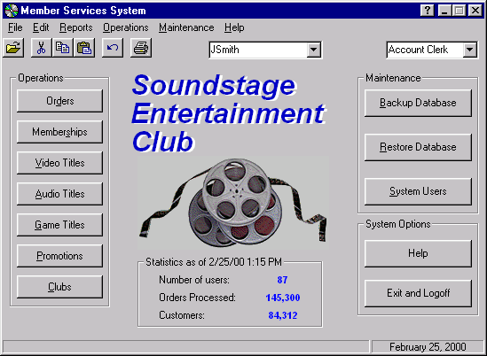
SoundStage Main Menu

Slide 33
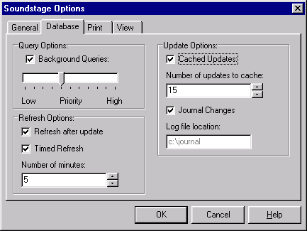
SoundStage Options and Preferences Screen

Slide 34
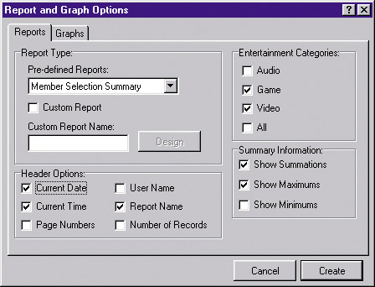
SoundStage Report Customization dialogue Screen

